Slide 1
XIII Encontro Nacional de Controle Interno
Governo Transparente e Aberto – Promovendo confiança para melhoria de resultados
Manaus, Amazonas, 4 de outobro,2017
Rafael Munoz Moreno
Banco Mundial
Líder do Programa Brasil, Crescimento Equitativo, Finanças e Instituições

Slide 2
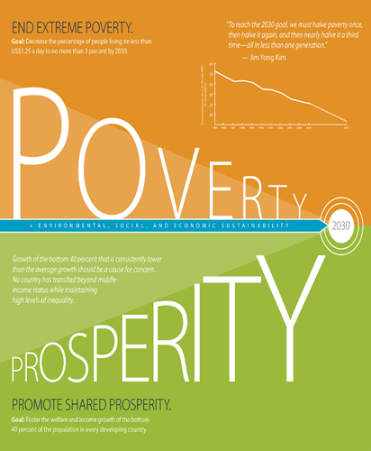
AGENDA
Introdução
Impacto da baixa confiança
Onde a confiança é e ganha ou
perdida?
O que conduz a confiança pública?
Como construir a confiança pública
O papel das instituições de supervisão
Principais Conclusões
LENDING
ASA
Active Projects or
84
300+ products in knowledge Program
$3.87 B
More than 150 active projects in other GPs are over 20% dedicated to Governance Components
FIDUCIARY
Governance Practice Staff provide fiduciary support to over 2,600 projects in the World Bank Portfolio

Slide 3
INTRODUÇÃO
A confiança influencia a relação entre cidadãos e governo e, por sua vez, tem um impacto nos resultados das políticas públicas.
Os níveis de confiança nas instituições variam, mas a confiança na maioria dos órgãos públicos diminuiu desde 2007.
Restaurar a confiança no governo é essencial.
Notes:
Trust plays a very tangible role in the effectiveness of government. Trust influences the relationship between citizens and government, and in turn has an impact on the outcomes of public policy.
Levels of trust in institutions vary, but trust in most public bodies has declined since 2007. Trust in government and political institutions has been hardest hit. Per the Gallup World Poll, between 2007 and 2015, trust in government decreased by an average of 2 percentage points in OECD member countries (from 45% to 43%). In the case of Brazil, trust in government has declined almost 21% since 1995.
Against a background of perceived inequalities in income and opportunities, high unemployment and job insecurity, resistance to globalization and concern over global pressures such as migration and climate change, restoring trust in Government is essential.

Slide 4
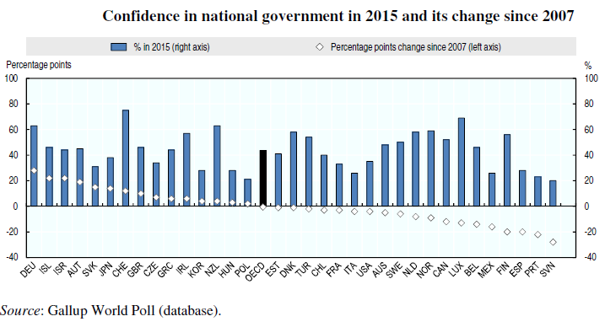
INTRODUÇÃO
Notes:
Trust plays a very tangible role in the effectiveness of government. Trust influences the relationship between citizens and government, and in turn has an impact on the outcomes of public policy.
Levels of trust in institutions vary, but trust in most public bodies has declined since 2007. Trust in government and political institutions has been hardest hit. Per the Gallup World Poll, between 2007 and 2015, trust in government decreased by an average of 2 percentage points in OECD member countries (from 45% to 43%). In the case of Brazil, trust in government has declined almost 21% since 1995.
Against a background of perceived inequalities in income and opportunities, high unemployment and job insecurity, resistance to globalization and concern over global pressures such as migration and climate change, restoring trust in Government is essential.

Slide 5
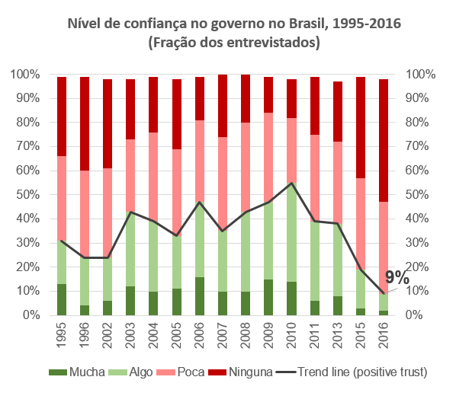
INTRODUÇÃO
Notes:
Trust plays a very tangible role in the effectiveness of government. Trust influences the relationship between citizens and government, and in turn has an impact on the outcomes of public policy.
Levels of trust in institutions vary, but trust in most public bodies has declined since 2007. Trust in government and political institutions has been hardest hit. Per the Gallup World Poll, between 2007 and 2015, trust in government decreased by an average of 2 percentage points in OECD member countries (from 45% to 43%). In the case of Brazil, trust in government has declined almost 21% since 1995.
Against a background of perceived inequalities in income and opportunities, high unemployment and job insecurity, resistance to globalization and concern over global pressures such as migration and climate change, restoring trust in Government is essential.

Slide 6
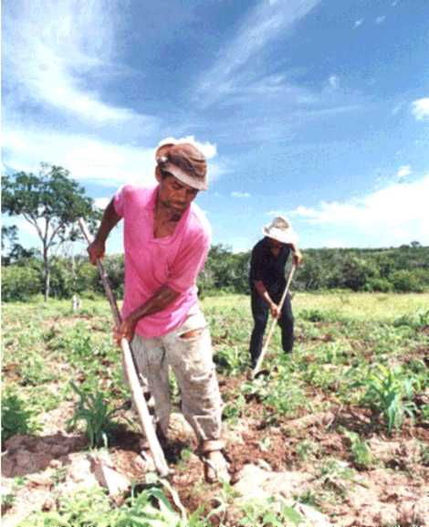
IMPACTO DA BAIXA CONFIANÇA
Torna mais difícil para os governos implementar políticas.
Diminui a geração de receita.
Aumenta o risco de quebra social e polarização
LENDING
ASA
Active Projects or
84
300+ products in knowledge Program
$3.87 B
More than 150 active projects in other GPs are over 20% dedicated to Governance Components
FIDUCIARY
Governance Practice Staff provide fiduciary support to over 2,600 projects in the World Bank Portfolio
Notes:
Governments cannot function effectively without the trust of citizens, nor can they successfully carry out public policies, notably more ambitious reform agendas.
Low trust can harm revenue generation – Citizens may be less likely to pay taxes if they do not have confidence that the money will be spent wisely and responsibly
Low trust can make it harder for governments to implement policy – Citizens may in general be less supportive of government decisions emerging from a non-transparent budget process.
Low trust can also increase the risk of societal break down and polarization, via the selection of radical political options and selling populist policies that aim to fix problems making others to look as the culprits.

Slide 7
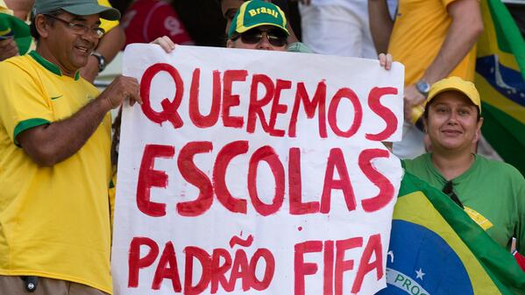
ONDE A CONFIANÇA É E GANHA OUPERDIDA?
Falta de crescimento econômico e seu impacto nos rendimentos, empregos e igualdade.
Raiva sobre problemas persistentes de corrupção, desvio de regulamentações e outros sinais de pouco respeito pelo estado de direito.
Pressões e riscos globais como mudanças climáticas, tensões geopolíticas, terrorismo e migração em larga escala.
Notes:
At least three major “pressure points” stand out as policy arenas in which trust is being won or lost:
Concern about the continuing lack of economic growth and its impact on incomes, jobs and equality.
Anger over persistent problems of corruption, tax evasion, regulatory capture and other signs of weak respect for rule of law.
Unease over the ability of governments to manage global pressures and risks such as climate change, geopolitical tensions, terrorism and large-scale migration.

Slide 8
O QUE CONDUZ A CONFIANÇA PÚBLICA?
O acesso a serviços de qualidade, como educação, saúde, transporte, segurança pública e justiça, é essencial para o desenvolvimento econômico e social.
A provisão de serviços públicos é um componente essencial da ação governamental oferecida em troca dos pagamentos de impostos dos cidadãos.
A experiência direta dos cidadãos e das empresas com esses serviços é importante para moldar suas atitudes em relação ao governo tanto local como nacional.
LENDING
ASA
Active Projects or
84
300+ products in knowledge Program
$3.87 B
More than 150 active projects in other GPs are over 20% dedicated to Governance Components
FIDUCIARY
Governance Practice Staff provide fiduciary support to over 2,600 projects in the World Bank Portfolio
Notes:
Access to quality services, such as education, health care, transportation, public security and justice, is essential to economic and social development.
The provision of public services is an essential component of government action offered in return for citizens’ tax payments.
The direct experience of citizens and businesses with these services matters in shaping their attitudes towards government, both local and national.

Slide 9
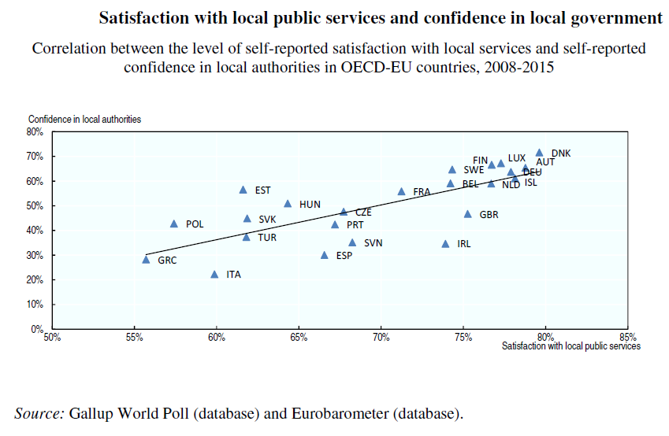
O QUE CONDUZ A CONFIANÇA PÚBLICA?
LENDING
ASA
Active Projects or
84
300+ products in knowledge Program
$3.87 B
More than 150 active projects in other GPs are over 20% dedicated to Governance Components
FIDUCIARY
Governance Practice Staff provide fiduciary support to over 2,600 projects in the World Bank Portfolio
Notes:
Access to quality services, such as education, health care, transportation, public security and justice, is essential to economic and social development.
The provision of public services is an essential component of government action offered in return for citizens’ tax payments.
The direct experience of citizens and businesses with these services matters in shaping their attitudes towards government, both local and national.

Slide 10
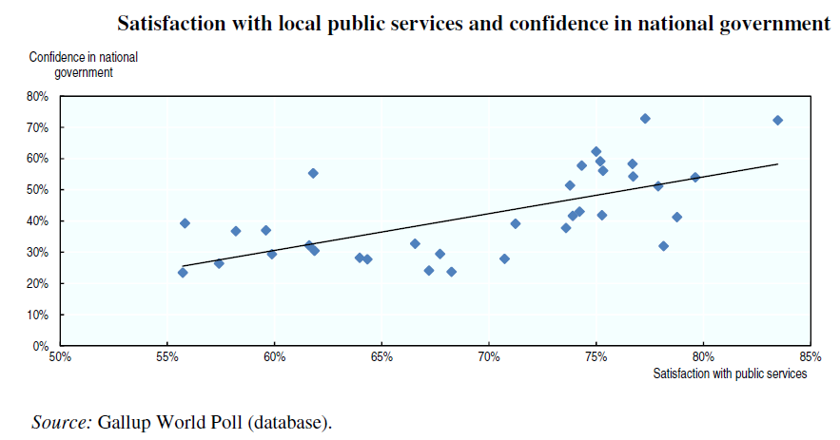
O QUE CONDUZ A CONFIANÇA PÚBLICA?
LENDING
ASA
Active Projects or
84
300+ products in knowledge Program
$3.87 B
More than 150 active projects in other GPs are over 20% dedicated to Governance Components
FIDUCIARY
Governance Practice Staff provide fiduciary support to over 2,600 projects in the World Bank Portfolio
Notes:
Access to quality services, such as education, health care, transportation, public security and justice, is essential to economic and social development.
The provision of public services is an essential component of government action offered in return for citizens’ tax payments.
The direct experience of citizens and businesses with these services matters in shaping their attitudes towards government, both local and national.

Slide 11
O QUE CONDUZ A CONFIANÇA PÚBLICA?
Dimensões tais como o engajamento com usuários reduz o hiato entre as expectativas e o desempenho.
Consistência no tratamento em diferentes grupos socioeconômicos e áreas geográficas.
RESPONSABILIDADE, ACESSO, QUALIDADE e EFICIÊNCIA, podem ajudar a melhorar os níveis de satisfação e, finalmente, estabelecer a confiança no governo.
LENDING
ASA
Active Projects or
84
300+ products in knowledge Program
$3.87 B
More than 150 active projects in other GPs are over 20% dedicated to Governance Components
FIDUCIARY
Governance Practice Staff provide fiduciary support to over 2,600 projects in the World Bank Portfolio
Notes:
Positive individual experiences of citizens with government agencies aggregate into a society in which government is respected as a competent and trustworthy “partner” of citizens in their daily lives. In other words, people’s satisfaction with public services is positively related to their trust in the government.
The quality of public services generates trust towards the governments institutional framework, and contributes to general compliance with rules and paying taxes. Poor public service access leads to a general distrust in the political system and, therefore, reduced political and tax participation.
Elements affecting the trust of citizens in government include not only those aspects related to government competence, in terms of the quality, timeliness and effectiveness of public services, but increasingly, dimensions such as engagement with users, leading to more tailored services or innovative forms of service design and delivery, contribute to shaping trust by reducing the gap between expectations and performance.
Likewise, consistency in treatment across different socio-economic groups and geographical areas informs generalized observations of fairness in service delivery as a key driver of trust in government.
Efforts aimed at better aligning services with the needs and expectations of citizens (i.e. ACCESS), improving their timeliness (i.e. RESPONSIVENESS) and their QUALITY and EFFICIENCY, can help improve levels of satisfaction, and ultimately trust in the government.

Slide 12
COMO CONSTRUIR A CONFIAÇA PÚBLICA-ELABORAÇÃO DE POLÍTICAS INCLUSIVAS
Mais oportunidades para a participação e contribuição dos cidadãos.
A França promulgou uma lei em 2015 que exige que o governo apresente indicadores de riqueza e bem-estar além do PIB - Ease of Doing Business, Poverty Gaps (Banco Mundial).
As consultas formais são frequentemente ou sempre realizadas em países altamente desenvolvidos. Por exemplo a Alemanha e África do Sul.
Gênero - Conselho de participação feminina na Espanha.
A Estratégia Nacional da Juventude-Irlandesa sobre a participação das crianças e jovens na tomada de decisões, 2015-2020.
LENDING
ASA
Active Projects or
84
300+ products in knowledge Program
$3.87 B
More than 150 active projects in other GPs are over 20% dedicated to Governance Components
FIDUCIARY
Governance Practice Staff provide fiduciary support to over 2,600 projects in the World Bank Portfolio
Notes:
Evidence suggests that government efforts to provide more opportunities for citizen participation and input into policy making represent an important strategy for improving trust in public institutions and policies.
For example, France enacted a law in 2015 requiring the government to present wealth and well-being indicators other than GDP when tabling the annual budget, to promote debate on policy impacts. The French authorities are currently planning to implement a strategic dashboard using a limited set of internationally-comparable indicators on the following three themes:
Economic development indicators, such as foreign direct investment flows to France (OECD), and “Ease of doing business” (World Bank).
Social progress indicators, such as healthy life expectancy at 65 by gender (OECD), percentage of 18-24 year-olds with no qualification and who are not in training (France Stratégie/Eurostat), and poverty gaps (World Bank).
Sustainable development indicators, such as greenhouse gas emissions per unit of GDP (European Energy Agency/Eurostat).
Formal consultations are frequently or always conducted in highly developed countries. In Germany, consultation with social partners (unions of natural or legal persons or groups to promote common interests) is formally required by law. According to the findings of the EU-15 Better Regulation project, those in the system apparently like this traditional method of consultation and feel that their economic and societal interests are heard and taken into consideration. In South Africa, the creation of the National Economic Development and Labor Council (NEDLAC) in the post-Apartheid era was also an important step in ensuring inclusive policy and law-making processes.
Spain’s Women Participation Council provides a channel for input by women’s associations and groups into the policy-making process and matters related to gender equality. Enlarging the involvement of stakeholders has also been prioritized in Latin American contexts, where there is a trend towards ensuring equitable representation from civil society, women’s organizations, academics and other experts on gender equality councils or commissions.
In Ireland, the National Strategy on Children and Young People’s Participation in Decision-making, 2015-2020, aims to have the voice of children and young people heard in decisions that affect their daily lives, including those that affect their education, health and well-being.

Slide 13
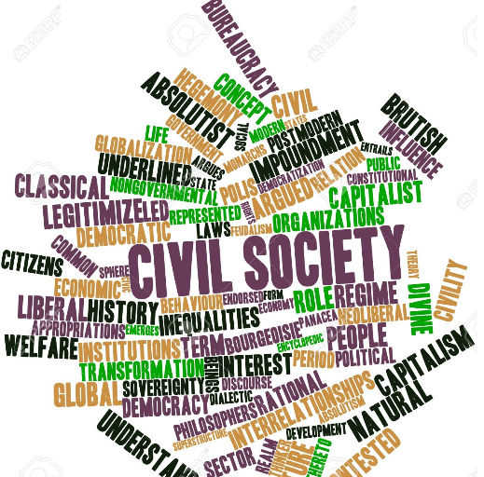
COMO CONSTRUIR A CONFIAÇA PÚBLICA-PROCESSO ORÇAMENTÁRIO
Confiança é sobre fazer promessas razoáveis antes da eleição;
Confiança é sobre os cidadãos terem voz no processo orçamentário;
Confiança é sobre entender como o dinheiro esta sendo usado;
Confiança é sobre saber que o futuro do país será atendido;
Confiança é ter fé na integridade e qualidade do processo de gestão financeira pública.
LENDING
ASA
Active Projects or
84
300+ products in knowledge Program
$3.87 B
More than 150 active projects in other GPs are over 20% dedicated to Governance Components
FIDUCIARY
Governance Practice Staff provide fiduciary support to over 2,600 projects in the World Bank Portfolio
Notes:
A government’s budget is a political appeal to voters, a statement of its program ambitions, and a guide to economic policy. The following dimensions of trust are relevant to budgeting and the budget process:
Trust is about making reasonable pre-election promises – This requires political parties to put forward reasonable and coherent policies that have been costed objectively, or indeed independently.
Trust is about citizens having a voice in the budget process – This requires ensuring that budget information is transparent and accessible to non-specialists, so that the public and civil society organizations can analyze how public money is being used and engage in the debate about budgetary choices and trade-offs. In this respect, Brazil was a leader in the early 1990’s with the adoption of Participatory Budgeting in the municipality of Porto Alegre, with subsequent expansion to other locales in Latin America and Europe. For example, since 2014 the municipality of Paris gives its citizens the opportunity to decide on the use of 5% of its investment budget, which amounts to 0.5 billion EUR in 2014-20. The aim is to involve citizens in municipal politics to foster social cohesion and to learn their preferences.
Trust is about understanding how money is being used – This requires openness with the public about the goals of the government and how and where resources are being allocated to fulfil them. Policy evaluation and performance assessment can also be undertaken to assess the impacts and outcomes of public expenditure and provide evidence to citizens that resources are being allocated effectively and efficiently.
Trust is about knowing that the country’s future is being looked after – This requires mechanisms and oversight arrangements to ensure that public finances are steered on a safe and prudent course that will avoid “boom and bust” and its negative repercussions for people’s lives.
Trust is about having confidence in the integrity and quality of the public financial management process – This requires full standardized professional accounting for public funds, budget transparency, and strong oversight institutions to guarantee integrity in the use of public funds and the quality of budget execution.

Slide 14
COMO CONSTRUIR A CONFIANÇA PÚBLICA-TRANSPARÊNCIA
Políticas, regulamentos e legislação abrangentes não são suficientes para garantir a transparência.
Ajudar o público a obter uma melhor compreensão das políticas e processos.
O aumento da transparência pode, a princípio, reduzir a confiança.
Extraordinário crescimento no monitoramento da despesa pública por cidadãos ou CSOs.
Exemplo do movimento social indiano Mazdoor Kisan Shakti Sangathan (MKSS).
Lado da Receita dos orçamentos.
Brasil-Inquérito sobre o Orçamento Aberto-Desempenho.
LENDING
ASA
Active Projects or
84
300+ products in knowledge Program
$3.87 B
More than 150 active projects in other GPs are over 20% dedicated to Governance Components
FIDUCIARY
Governance Practice Staff provide fiduciary support to over 2,600 projects in the World Bank Portfolio
Notes:
Transparency helps the public gain a better understanding of policies and processes. Thus, citizens’ trust in government can be expected to increase.
Governments can increase transparency through several mechanisms. Nevertheless, even comprehensive policies, regulation and legislation that guarantees access to public information and that lays out the institutional structure is not sufficient to ensure transparency.
More transparency can expose mistakes as well as corruption. Increased transparency, therefore, does not automatically lead to increased trust. In fact, increased transparency may at first reduce trust, as controversial information or cases of corruption are brought to light.
The past two decades have also seen tremendous growth in monitoring public expenditure by citizens or CSOs in order to promote the efficient delivery of stated government policies and priorities. Monitoring activities have taken a variety of forms.
Perhaps the most prominent, is the social audit scheme developed by the Indian social movement Mazdoor Kisan Shakti Sangathan (MKSS, Association for the Empowerment of Workers and Farmers). To stamp out corruption in the state of Rajasthan, the MKSS launched a participatory process through which citizens could monitor the implementation of government programs in their communities. The MKSS model has since been replicated in many other States of India and in other parts of the World. The Concerned Citizens of Abra for Good Governance in the Philippines and Muslims for Human Rights in Kenya have also engaged in participatory audits, while groups in South Africa and Tanzania have monitored and publicized the results of official government audits.
In Argentina, The Civil Association for Equality and Justice (ACIJ) launched a campaign to push the City of Buenos Aires to comply with its legal obligation to provide free public education to children between the ages of 45 days and five years. While the campaign is ongoing, ACIJ has already managed to secure more places for students, better spending on infrastructure, and a new system of online enrollment. The success of ACIJ’s campaign hinged on its ability to adapt to a dynamic political environment, changing tactics where appropriate. Responding to a breakdown in the formal mechanisms for monitoring government compliance, the ACIJ lobbied both the executive and the legislature, took further legal action, and mobilized public support through the media and other advocacy efforts.
Citizens have also begun engaging with the revenue side of budgets. While there are fewer examples of initiatives in this area, and they tend to be concentrated in higher-income countries, existing initiatives show the promise of this type of work. For instance, state-level groups in the United States have successfully pushed for progressive tax reforms and adequate revenue levels. Groups in some lower- and middle-income countries have expanded public understanding of revenue issues and influenced government revenue policies. In Kenya, for instance, the National Taxpayers’ Association, an initiative of the Centre for Governance and Development, is working to strengthen public understanding of existing tax burdens and of the connection between taxes and public spending. International ‘tax-justice’ efforts have been launched to ensure that multinational corporations pay their fair share of revenues, and that information on these payments is made public.

Slide 15
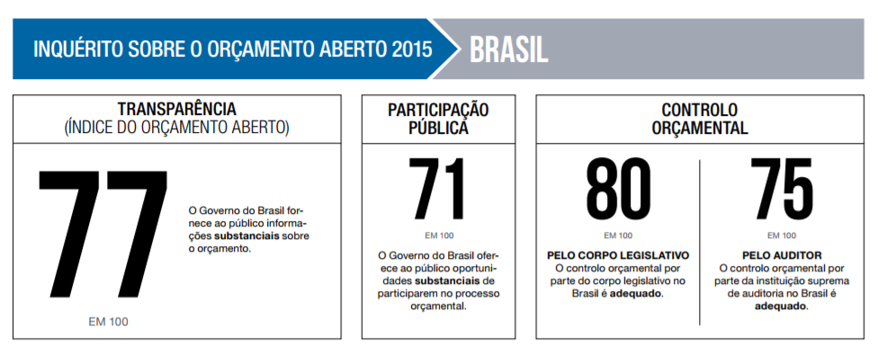
COMO CONSTRUIR A CONFIANÇA PÚBLICA-TRANSPARÊNCIA
LENDING
ASA
Active Projects or
84
300+ products in knowledge Program
$3.87 B
More than 150 active projects in other GPs are over 20% dedicated to Governance Components
FIDUCIARY
Governance Practice Staff provide fiduciary support to over 2,600 projects in the World Bank Portfolio
Notes:
Transparency helps the public gain a better understanding of policies and processes. Thus, citizens’ trust in government can be expected to increase.
Governments can increase transparency through several mechanisms. Nevertheless, even comprehensive policies, regulation and legislation that guarantees access to public information and that lays out the institutional structure is not sufficient to ensure transparency.
More transparency can expose mistakes as well as corruption. Increased transparency, therefore, does not automatically lead to increased trust. In fact, increased transparency may at first reduce trust, as controversial information or cases of corruption are brought to light.
The past two decades have also seen tremendous growth in monitoring public expenditure by citizens or CSOs in order to promote the efficient delivery of stated government policies and priorities. Monitoring activities have taken a variety of forms.
Perhaps the most prominent, is the social audit scheme developed by the Indian social movement Mazdoor Kisan Shakti Sangathan (MKSS, Association for the Empowerment of Workers and Farmers). To stamp out corruption in the state of Rajasthan, the MKSS launched a participatory process through which citizens could monitor the implementation of government programs in their communities. The MKSS model has since been replicated in many other States of India and in other parts of the World. The Concerned Citizens of Abra for Good Governance in the Philippines and Muslims for Human Rights in Kenya have also engaged in participatory audits, while groups in South Africa and Tanzania have monitored and publicized the results of official government audits.
In Argentina, The Civil Association for Equality and Justice (ACIJ) launched a campaign to push the City of Buenos Aires to comply with its legal obligation to provide free public education to children between the ages of 45 days and five years. While the campaign is ongoing, ACIJ has already managed to secure more places for students, better spending on infrastructure, and a new system of online enrollment. The success of ACIJ’s campaign hinged on its ability to adapt to a dynamic political environment, changing tactics where appropriate. Responding to a breakdown in the formal mechanisms for monitoring government compliance, the ACIJ lobbied both the executive and the legislature, took further legal action, and mobilized public support through the media and other advocacy efforts.
Citizens have also begun engaging with the revenue side of budgets. While there are fewer examples of initiatives in this area, and they tend to be concentrated in higher-income countries, existing initiatives show the promise of this type of work. For instance, state-level groups in the United States have successfully pushed for progressive tax reforms and adequate revenue levels. Groups in some lower- and middle-income countries have expanded public understanding of revenue issues and influenced government revenue policies. In Kenya, for instance, the National Taxpayers’ Association, an initiative of the Centre for Governance and Development, is working to strengthen public understanding of existing tax burdens and of the connection between taxes and public spending. International ‘tax-justice’ efforts have been launched to ensure that multinational corporations pay their fair share of revenues, and that information on these payments is made public.

Slide 16
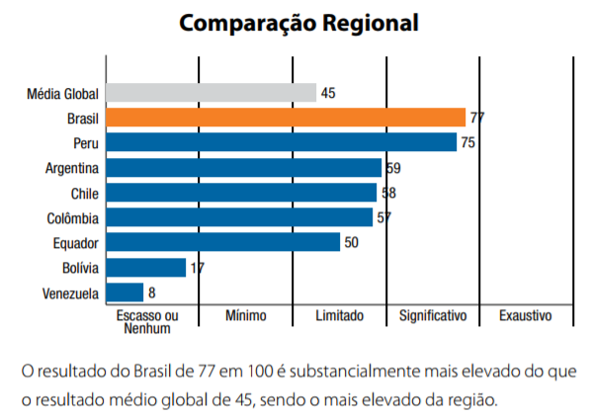
COMO CONSTRUIR A CONFIANÇA PÚBLICA-TRANSPARÊNCIA
LENDING
ASA
Active Projects or
84
300+ products in knowledge Program
$3.87 B
More than 150 active projects in other GPs are over 20% dedicated to Governance Components
FIDUCIARY
Governance Practice Staff provide fiduciary support to over 2,600 projects in the World Bank Portfolio
Notes:
Transparency helps the public gain a better understanding of policies and processes. Thus, citizens’ trust in government can be expected to increase.
Governments can increase transparency through several mechanisms. Nevertheless, even comprehensive policies, regulation and legislation that guarantees access to public information and that lays out the institutional structure is not sufficient to ensure transparency.
More transparency can expose mistakes as well as corruption. Increased transparency, therefore, does not automatically lead to increased trust. In fact, increased transparency may at first reduce trust, as controversial information or cases of corruption are brought to light.
The past two decades have also seen tremendous growth in monitoring public expenditure by citizens or CSOs in order to promote the efficient delivery of stated government policies and priorities. Monitoring activities have taken a variety of forms.
Perhaps the most prominent, is the social audit scheme developed by the Indian social movement Mazdoor Kisan Shakti Sangathan (MKSS, Association for the Empowerment of Workers and Farmers). To stamp out corruption in the state of Rajasthan, the MKSS launched a participatory process through which citizens could monitor the implementation of government programs in their communities. The MKSS model has since been replicated in many other States of India and in other parts of the World. The Concerned Citizens of Abra for Good Governance in the Philippines and Muslims for Human Rights in Kenya have also engaged in participatory audits, while groups in South Africa and Tanzania have monitored and publicized the results of official government audits.
In Argentina, The Civil Association for Equality and Justice (ACIJ) launched a campaign to push the City of Buenos Aires to comply with its legal obligation to provide free public education to children between the ages of 45 days and five years. While the campaign is ongoing, ACIJ has already managed to secure more places for students, better spending on infrastructure, and a new system of online enrollment. The success of ACIJ’s campaign hinged on its ability to adapt to a dynamic political environment, changing tactics where appropriate. Responding to a breakdown in the formal mechanisms for monitoring government compliance, the ACIJ lobbied both the executive and the legislature, took further legal action, and mobilized public support through the media and other advocacy efforts.
Citizens have also begun engaging with the revenue side of budgets. While there are fewer examples of initiatives in this area, and they tend to be concentrated in higher-income countries, existing initiatives show the promise of this type of work. For instance, state-level groups in the United States have successfully pushed for progressive tax reforms and adequate revenue levels. Groups in some lower- and middle-income countries have expanded public understanding of revenue issues and influenced government revenue policies. In Kenya, for instance, the National Taxpayers’ Association, an initiative of the Centre for Governance and Development, is working to strengthen public understanding of existing tax burdens and of the connection between taxes and public spending. International ‘tax-justice’ efforts have been launched to ensure that multinational corporations pay their fair share of revenues, and that information on these payments is made public.

Slide 17
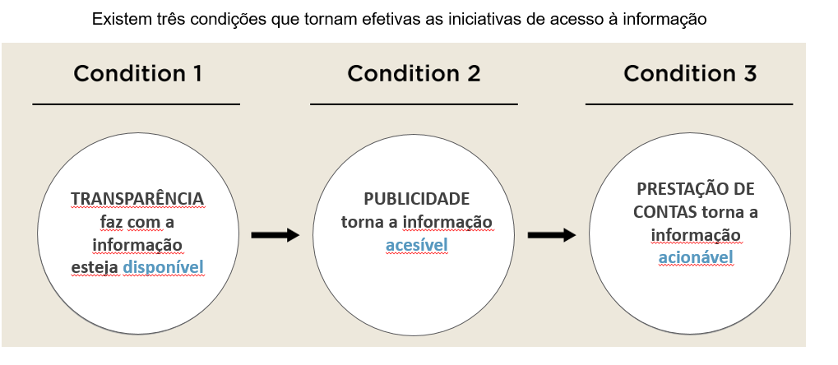
COMO CONSTRUIR A CONFIANÇA PÚBLICA-TRANSPARÊNCIA
LENDING
ASA
Active Projects or
84
300+ products in knowledge Program
$3.87 B
More than 150 active projects in other GPs are over 20% dedicated to Governance Components
FIDUCIARY
Governance Practice Staff provide fiduciary support to over 2,600 projects in the World Bank Portfolio
Notes:
Transparency helps the public gain a better understanding of policies and processes. Thus, citizens’ trust in government can be expected to increase.
Governments can increase transparency through several mechanisms. Nevertheless, even comprehensive policies, regulation and legislation that guarantees access to public information and that lays out the institutional structure is not sufficient to ensure transparency.
More transparency can expose mistakes as well as corruption. Increased transparency, therefore, does not automatically lead to increased trust. In fact, increased transparency may at first reduce trust, as controversial information or cases of corruption are brought to light.
The past two decades have also seen tremendous growth in monitoring public expenditure by citizens or CSOs in order to promote the efficient delivery of stated government policies and priorities. Monitoring activities have taken a variety of forms.
Perhaps the most prominent, is the social audit scheme developed by the Indian social movement Mazdoor Kisan Shakti Sangathan (MKSS, Association for the Empowerment of Workers and Farmers). To stamp out corruption in the state of Rajasthan, the MKSS launched a participatory process through which citizens could monitor the implementation of government programs in their communities. The MKSS model has since been replicated in many other States of India and in other parts of the World. The Concerned Citizens of Abra for Good Governance in the Philippines and Muslims for Human Rights in Kenya have also engaged in participatory audits, while groups in South Africa and Tanzania have monitored and publicized the results of official government audits.
In Argentina, The Civil Association for Equality and Justice (ACIJ) launched a campaign to push the City of Buenos Aires to comply with its legal obligation to provide free public education to children between the ages of 45 days and five years. While the campaign is ongoing, ACIJ has already managed to secure more places for students, better spending on infrastructure, and a new system of online enrollment. The success of ACIJ’s campaign hinged on its ability to adapt to a dynamic political environment, changing tactics where appropriate. Responding to a breakdown in the formal mechanisms for monitoring government compliance, the ACIJ lobbied both the executive and the legislature, took further legal action, and mobilized public support through the media and other advocacy efforts.
Citizens have also begun engaging with the revenue side of budgets. While there are fewer examples of initiatives in this area, and they tend to be concentrated in higher-income countries, existing initiatives show the promise of this type of work. For instance, state-level groups in the United States have successfully pushed for progressive tax reforms and adequate revenue levels. Groups in some lower- and middle-income countries have expanded public understanding of revenue issues and influenced government revenue policies. In Kenya, for instance, the National Taxpayers’ Association, an initiative of the Centre for Governance and Development, is working to strengthen public understanding of existing tax burdens and of the connection between taxes and public spending. International ‘tax-justice’ efforts have been launched to ensure that multinational corporations pay their fair share of revenues, and that information on these payments is made public.

Slide 18
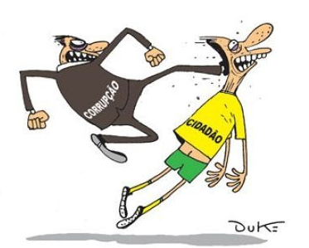
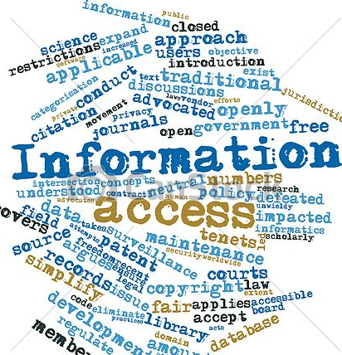
O PAPEL DAS INSTITUIÇÕES DE SUPERVISÃO
Canais de uma boa governança do setor público.
Autonomia e poder para exercer os poderes que lhes são conferidos de forma independente e objetiva.
Cada parte funcional da democracia também tem suas instituições de responsabilidade e supervisão e devem respeitar seu TdRs e responsabilidades.
Reformas contínuas foram feitas na última década.
O Portal de Transparência dos Governos.
A Lei de Acesso à Informação.
Auditoria Interna Moderna.
Aplicação do IA-CM; bom exemplo da CGE-DF.
LENDING
ASA
Active Projects or
84
300+ products in knowledge Program
$3.87 B
More than 150 active projects in other GPs are over 20% dedicated to Governance Components
FIDUCIARY
Governance Practice Staff provide fiduciary support to over 2,600 projects in the World Bank Portfolio
Notes:
Strong oversight institutions are the cornerstones of good public sector governance. By providing unbiased, objective assessments of whether public resources are managed responsibly and effectively to achieve intended results, oversight institutions help other public sector organizations achieve accountability and integrity, improve operations, and instill confidence among citizens and stakeholders.
Society today has become very aware and demanding. Accountability institutions must be granted autonomy and allowed to exercise the powers vested in them independently and objectively. They must be allocated the resources and skills required to improve their effectiveness. This will help to repose public confidence in the functioning of the government. Yet, each functioning part of the democracy also has its’ responsibility and oversight institutions have also to abide to their ToR and responsibilities.
The federal and various state governments have undertaken continuous reforms over the past decade to enhance integrity and prevent corruption within its public administration. These reforms have focused on: i) increasing transparency and direct citizen oversight over public service delivery; ii) introducing a risk-based approach to internal control within public organizations; and iii) promoting high standards of conduct among public officials. Nevertheless, the results are mixed, as corruption has not declined and continues to persist, although it is being exposed and brought to light.
The following control mechanisms that promote trust and transparency were developed during the last 10 years:
The cadaster of inept and suspended firms;
The Public Expense Observatory that monitors, checks and cross checks the information provided in different systems; and
Inter-institutional articulation and partnerships with other control entities.
The following mechanisms to enable citizens to demand public services were also developed:
The FixMyStreet Website that already exists in Brazil http://www.fixmystreet.com.br/;
The Transparency Portal that gives detailed information about public expenditure in Brazil: http://www.portaltransparencia.gov.br/.
The Transparency Portal of Governments is an important instrument for social control, that is being effectively used by the population. For example, all funds transferred to states, municipalities and NGOs through agreements, benefits paid under the Bolsa Família Program, operations carried out with Federal Government payment cards, funds invested the 2014 World Cup and the 2016 Olympics, and the salaries of all federal and state civil servants are disclosed on the portal.
The Law of Access to Information broke with the culture of secrecy that had ruled the state for centuries, determining that all information is, as a rule, public. The Law also established short deadlines for responses to citizens' requests for access, holding officials accountable for them and encouraging the disclosure of data in open formats a measure to stimulate public transparency.

Slide 19
CONCLUSÕES
A melhora dos serviços públicos tem um papel importante no fortalecimento da confiança no governo.
Os governos precisam garantir que o processo de tomada de decisão com relação ao orçamento seja aberto e que forneça um debate inclusivo, participativo e realista sobre as opções orçamentárias.
Os esforços para uma maior abertura enviam um sinal claro do compromisso do governo em investir em confiança.
Instituições de supervisão que operam de forma independente geram confiança no governo.
LENDING
ASA
Active Projects or
84
300+ products in knowledge Program
$3.87 B
More than 150 active projects in other GPs are over 20% dedicated to Governance Components
FIDUCIARY
Governance Practice Staff provide fiduciary support to over 2,600 projects in the World Bank Portfolio
Notes:
Improving public services, in terms of access, quality, effectiveness and responsiveness, plays an important role in strengthening trust in government: service performance, citizen satisfaction and public trust are closely connected.
Governments need to ensure that the budget decision-making process itself is open and provides for an inclusive, participative and realistic debate on budgetary choices, and not simply provide access to information once spending decisions have been made.
Efforts towards greater openness send a clear signal of a government’s commitment to invest in trust while improving the quality of the decisions made even if in some cases this openness illuminates’ facts that generate distrust.
The legislature, supreme audit institutions and independent control institutions are all oversight institutions that, when operating independently and effectively, can help guarantee integrity in the use of public funds and the quality of budget execution, and therefore generate trust in government.

Slide 20
LENDING
ASA
Active Projects or
84
300+ products in knowledge Program
$3.87 B
More than 150 active projects in other GPs are over 20% dedicated to Governance Components
OBRIGADO!!
FIDUCIARY
Governance Practice Staff provide fiduciary support to over 2,600 projects in the World Bank Portfolio

