Slide 1


Ferramentas de transparência para prevenir e processar criminalmente a corrupção na esfera pública
M. Kendall Day
Chefe adjunto
Seção de Integridade Pública
Departamento de Justiça dos EUA
+1-202-353-2248
m.kendall.day@usdoj.gov
Notes:
Welcome interruptions and questions.
Slides, but presentation is better with input and questions.

Slide 2
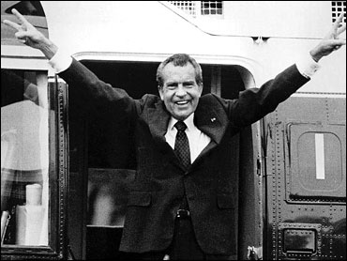
Introdução
Seção de Integridade Pública
  Criada em 1976
  Processar criminalmente
  Assessorar e assistir
  Informar
Notes:
Public Integrity Section
*Est. 1976
*Consolidate oversight of PC cases
*Prosecute select, important cases. Many recusals
*give advice to prosecutors in the field
*report to Congress and public on PC cases after they have become public
*

Slide 3
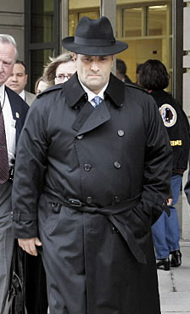
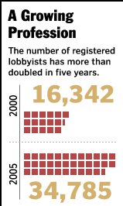
Visão geral do estudo de caso
Lobista = contratado para influenciar autoridades públicas em nome de um determinado setor, grupo ou indivíduo
Notes:
Use case study to give overview of US practice. Part of discussion will focus on transparency – what types of laws and regulations require public reporting of certain activities. Part of discussion will focus on how – when the rules of transparency are broken – that fact can be powerful evidence in a corruption prosecution.
Lobbyist defined.
Lobbying disclosure act. Potential for corruption. People who make a certain amount of money as paid lobbyists are required to file quarterly reports explaining: (a) who they are; (b) who their clients are; © how much the clients pay; (d) the issues they lobby for; (e) and who they lobby
Particular lobbyist = Abramoff. Powerful.
a) Ordinarily, lobbyists work in gov’t, then leave gov’t and are hired to lobby the public officials they previously worked with.

Slide 4
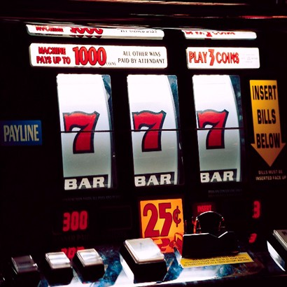
Lobby
Clientes de tribos de índios americanos
As tribos podem operar cassinos
Clientes queriam abrir cassinos ou impedir a abertura de cassinos por concorrentes
Notes:
Clients = native american triabes
Tribes may operate casinos.
Las Vegas = exception
Law allows tribes to open casinos if first granted certain status by the national gov’t
Casinos are huge money makers
3) Clients wanted to open casinos or prevent competing casinos

Slide 5
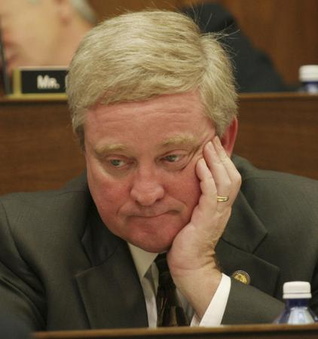
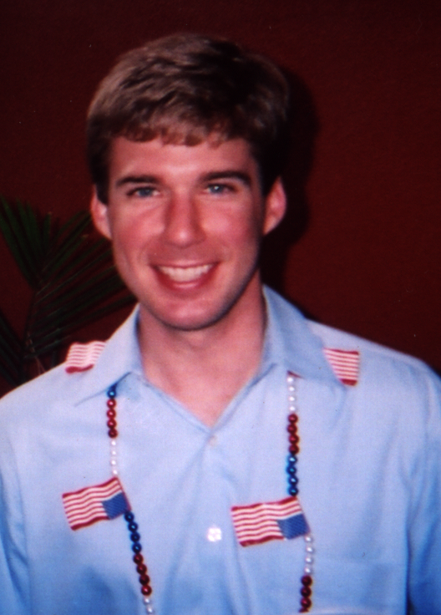
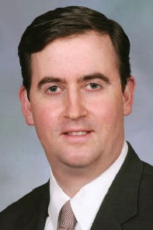
Autoridades públicas
Notes:
Ney: 56; chair of committee with jurisdiction over HAVA
Volz: 39; Ney’s COS for many years; 2/02, left to work for JA as a lobbyist
Heaton: Ney’s COS; 25 in picture; started at 23; Ney’s decision to pick Heaton b/c young and inexperienced
Systemic problem – no pay, long hours, no training
Tip – look for systemic problems because you’ll find corruption

Slide 6
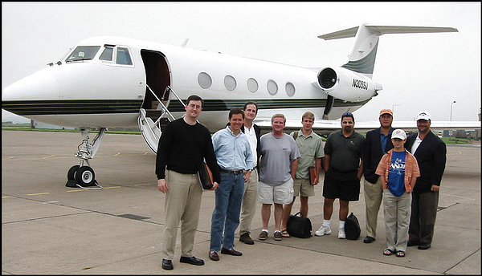
Alegações
Coisas de valor (viagens, ingressos para eventos esportivos, contribuições ilegais para campanhas)
Ato oficial (emenda para permitir tribo a abrir cassino)

Slide 7

Escritório de Ética Governamental:
Formulários de Declaração Financeira
Histórico
Funções
  Propor novas regras e diretrizes de ética
  Resolver questões sobre regras existentes
  Receber, analisar e publicar formulários de declaração de bens
Cooperação
  Obter provas
  Obter testemunhas
Notes:
Background: 1978 as post-Water Gate reform
Resolve questions: advisory opinions.
Receive, review and publish: maintain confidential forms, too.

Slide 8
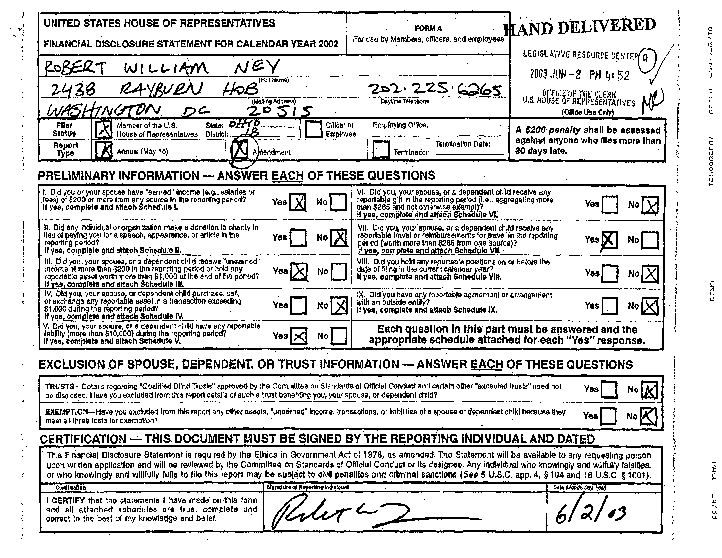

Slide 9
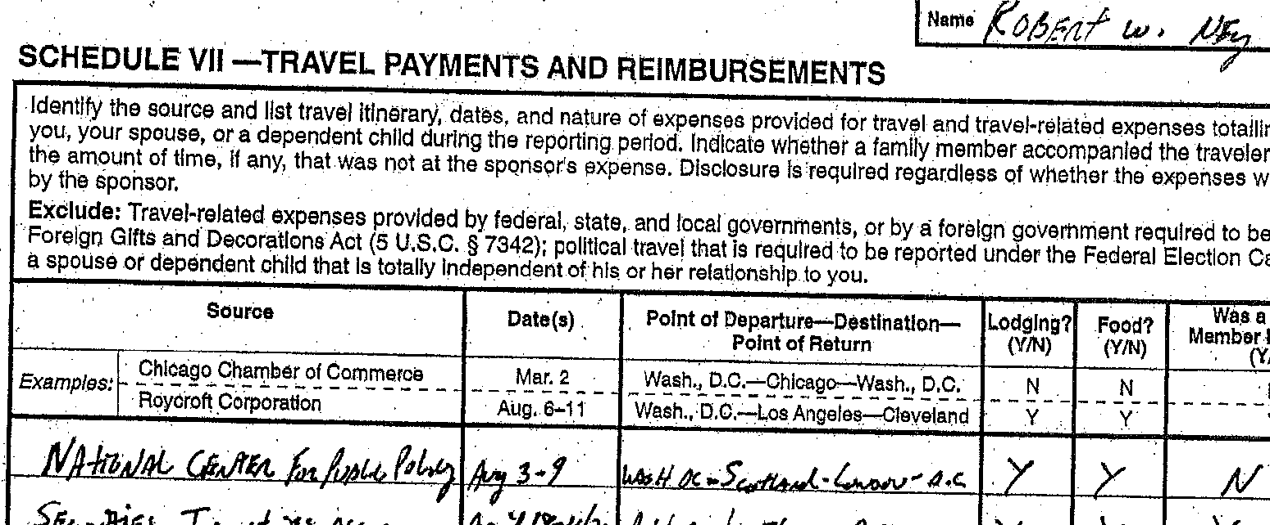

Slide 10

Comissão Eleitoral Federal:
Campanha Declaração Financeira
Histórico
  É preciso informar (1) fonte de contribuição; (2) valores; e (3) data
Funções
  Receber e publicar relatórios de declaração de bens
Cooperação
  Obter provas
  Obter testemunhas

Slide 11
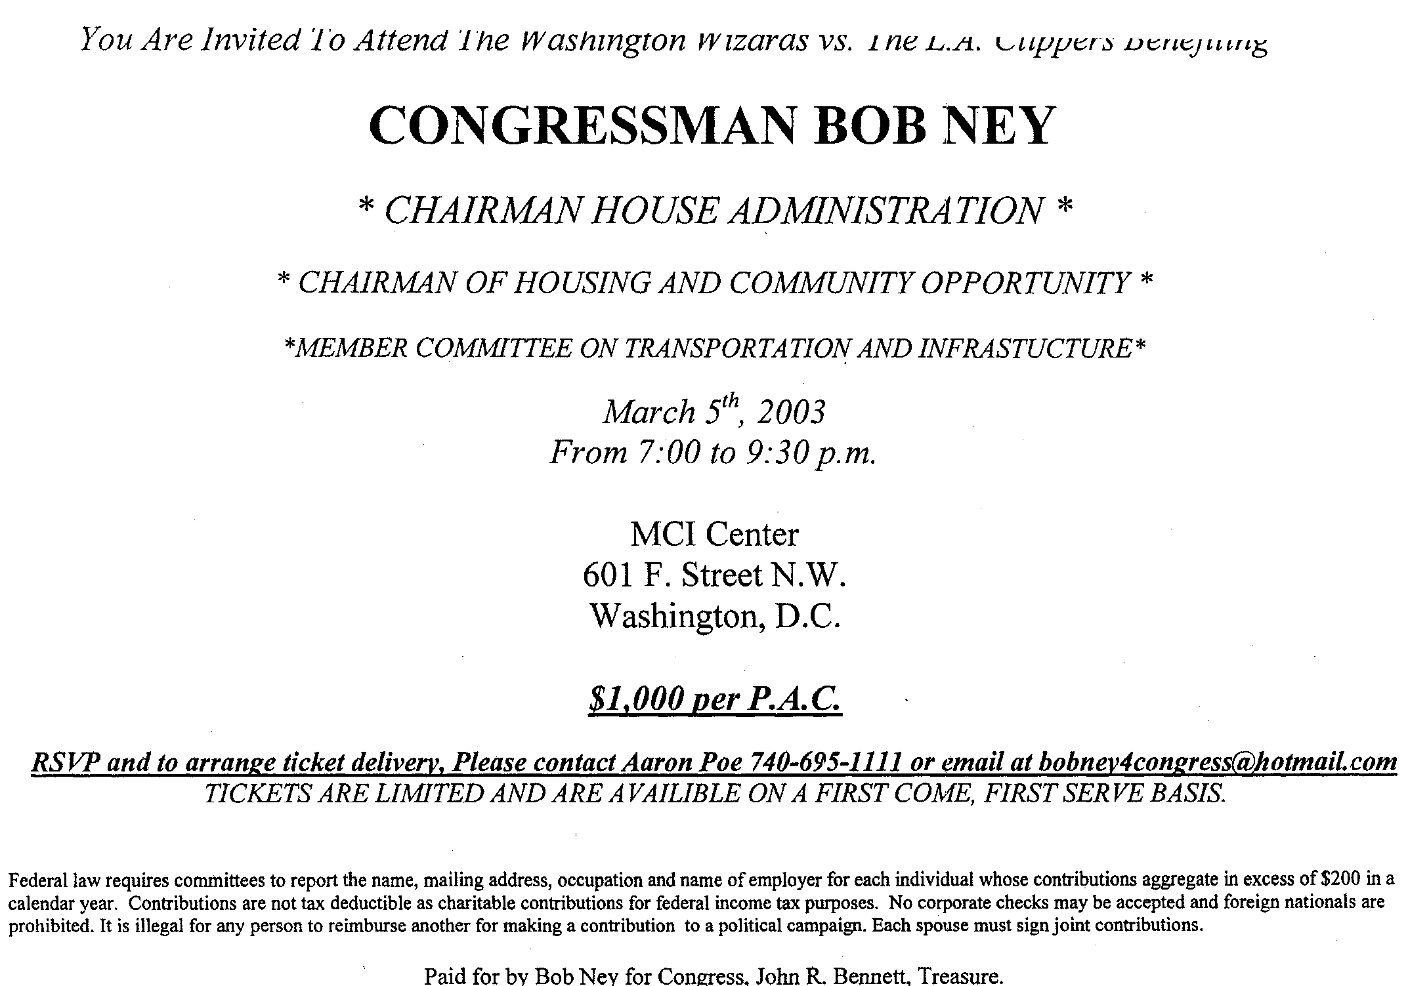

Slide 12

Receita Federal:
Análise financeira
Histórico
Função
Cooperação
  Obter provas
  Obter testemunhas
  Investigadores adicionais especialmente treinados

Slide 13
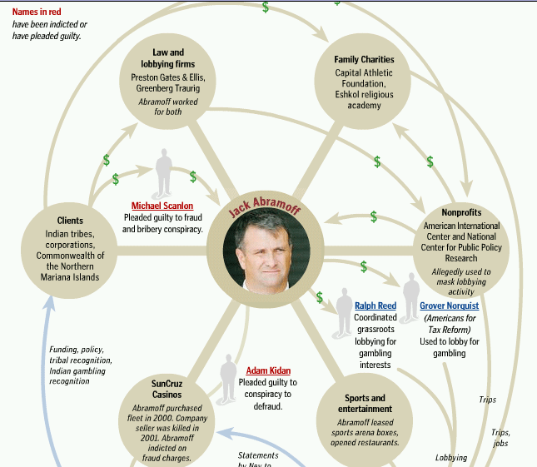

Slide 14
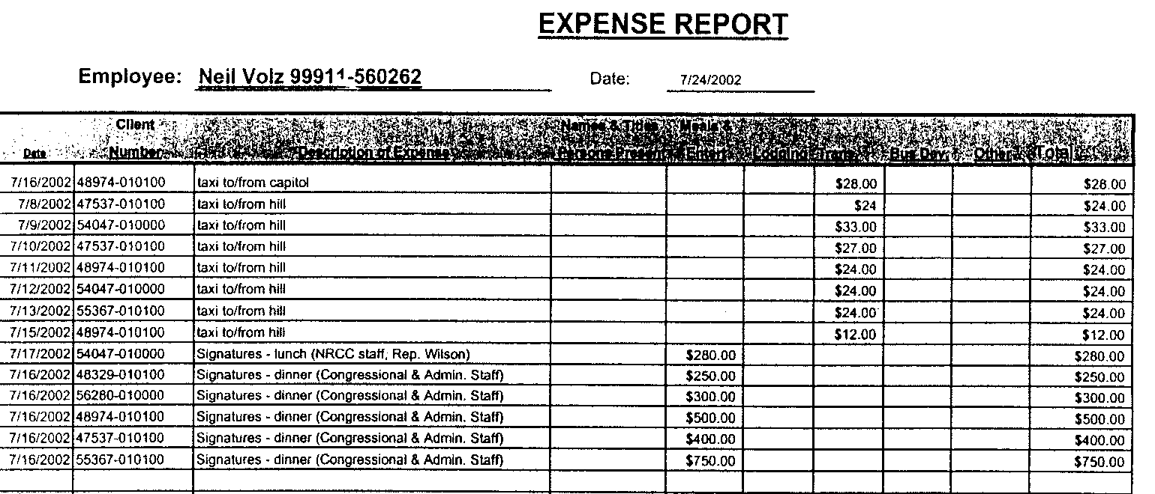
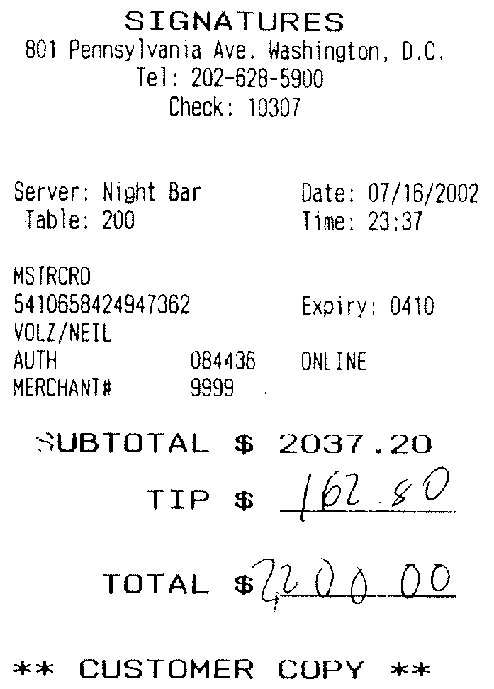

Slide 15
Notes:
Opportunities presented by public officials – lots of false public statements that are helpful to show criminal intent.
Point: rarely see evidence of bribery agreement written down.
***Usually have to ask the judge to infer that a bribe was meant to influence official action from other facts. One helpful fact is when public official tries to hide or misrepresent what took place.
***Guilty conscience evidence. Only reason to try and hide is because official has a guilty conscience
***Not a crime to lie to the press. But, it can be helpful to us in criminal case as we can argue that the purpose of lying to the press (and to voters) is to conceal a corrupt relationship.

Slide 16
Notes:
So, after looking at Charity not mentioned in email…
Golf, drinking, and smoking cuban cigars = activities on the trip.

Slide 17
Fevereiro – Volz deixa escritório de Ney
Julho – Assistente de Ney tenta inserir emenda de jogo
Setembro – Assistente de Ney tenta novamente inserir emenda de jogo
Maio – Ney convidado para ir à Escócia
Agosto – Viagem à Escócia
Notes:
Circumstantial evidence that trip was given in exchange for official action of inserting gambling amendment. Ney’s false statements to the press are part of circumstantial evidence.
Here’s another great source of circumstantial evidence: timing.
August: about six months after Volz left Ney’s office and started working for JA. Anyone want to wager whether Volz talked with Ney about business during the trip?

Slide 18
Possíveis acusações
Suborno
Declaração financeira falsa
Evasão fiscal
Veto de um ano
Relatório falso de campanha ou lavagem de contribuição
Notes:
Bribery
Our law = 15 years
False financial disclosure
Our law = 5 years
Tax Evasion
Our law = 5 years
One-year ban
Our law = 5 years
False campaign report or laudering campaign contribution
Our law: conduit contributions = laundering contribution. 5 years (for more than $25,000)

Slide 19
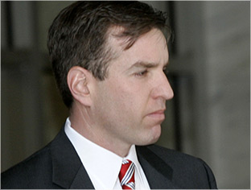
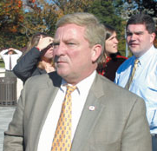
Notes:
Results matter
Abramoff: Bribery, one-year ban, tax evasion, and fraud
Witness collaborator. Credited with helping prosecutions of many other figures.
44 months in jail.
Rudy: Bribery.
5 months in a halfway house
Heaton: Bribery.
Extraordinary cooperation – wore a wire with boss, Ney.
Recommended halfway house.
Judge ordered probation.
Volz: Bribery, one-year ban.
extraordinary cooperation: testified as gov’t witness in 4 trials involving other defendants.
recommended home detention.
Judge ordered probation.
Ney: Bribery, one-year ban, false financial disclosure
27 months prison.

Slide 20
M. Kendall Day
Chefe adjunto
Seção de Integridade Pública
Departamento de Justiça dos EUA
+1-202-353-2248
m.kendall.day@usdoj.gov
Notes:
Questions?

