Slide 1
Seminário O controle interno governamental no Brasil Velhos Desafios, Novas Perspectivas
14 a 16 de Maio
Iguassu Resort – Foz do Iguaçu - Paraná

Slide 2
World Bank View of Internal Controls
Perspective based on Bank’s Internal Controls over its Operations and Financial Reporting Framework
Observations from implementation and oversight of Bank-financed projects

Slide 3
The Bank Reforms
The Bank’s twin Goals: Reduce poverty and increase shared prosperity
Focus of the reforms on results through:
One World Bank
A knowledge and solutions Bank
Creating a culture of informed risk-taking
Establish a Unified Operations Risk Management Framework that puts clients at the center of all we do
Building institutional architecture and policies that support informed risk management and move resources to the front lines
Improving effectiveness of management interaction with oversight entities

Slide 4
Review of Bank Policies and Processes
Efficiency Reviews:
Identifying key internal controls to reduce bureaucracy
Building a clear link between risks and controls
Creating a clear Accountability and Decision Making Framework
Creating a technology platform that allows for simple and clear identification and recording of risks and accountabilities and the related internal controls

Slide 7
Key Lessons So Far
Focus on risk-based controls and having appropriate/single decisions makers creates accountability and transparency and improves speed and efficiency of delivery
Using the internal audit function to review efficiency and effectiveness as well as compliance helps improve quality of policies and processes

Slide 8
Bank-Financed Projects: Some Observations
Internal controls & the Audit function – as an integrated control framework
There is a direct link between lack of transparency, weak internal controls/audit functions, and instances of fraud, corruption and lack of efficiency and effectiveness in bank projects
Even where internal controls have been put in place, problems arise due to breach of those controls – hence the need for a strong audit function
In a decentralized system (where local capacity may vary) an effective and efficient rules-based PFM system of internal controls and high quality audit function that promotes efficiency, transparency and accountability is an essential tool
Risk Based Internal Controls
Audits – Internal and External
Transparency
& Accountability

Slide 9
Observations from some decentralized systems

Slide 10
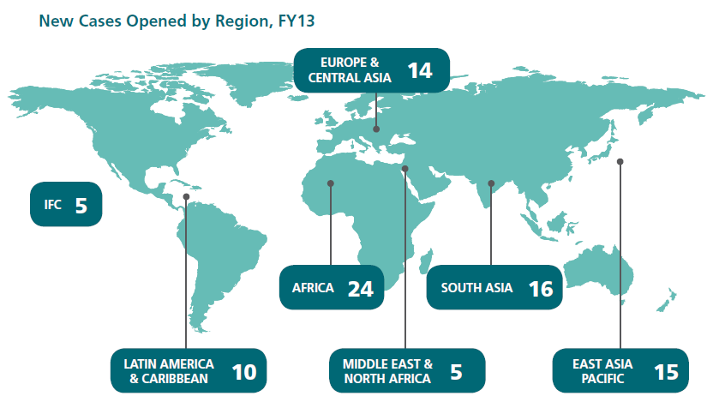
Some Analysis Based on Integrity Reviews
89 cases

Slide 11
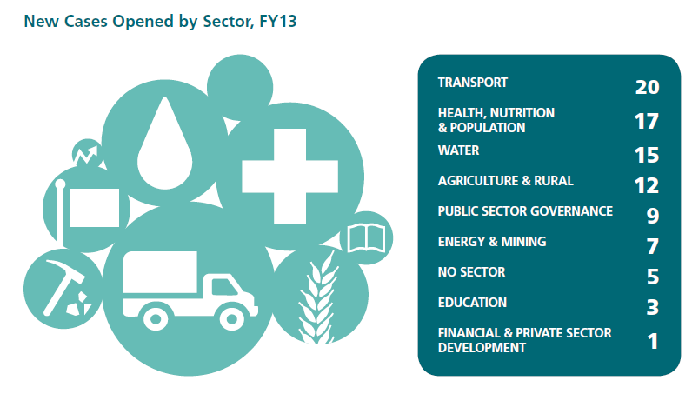

Slide 12
Selected case studies of weak IC: Case 1
Findings
Items purchased not included in the procurement plan.
Cash checks around USD 1.7M not entered in the cash book and recorded in a separate register
Weak IC
Overall weak IC system
Weak procurement practices.
Budgetary controls not in place that resulted in procurements of assets not supposed to be made.
Non maintenance of complete accounts and delayed accounts reconciliation
Control deficiencies during authorization of transactions and supervision and monitoring of operations.
No proper segregation of duties and retention of records.
Fraudulent invoices- same handwriting in the PIU voucher and the vendor invoice
Fake invoices were found in respect of food for participants of training from 10 vendors
Unauthorized payment as honorarium to national coordinators and facilitators

Slide 13
Selected case studies of weak IC: Case 2
Findings
Overpaid contracts
Unauthorized Staff contracts
Weak IC
Weak accounting and budgetary system
Control deficiencies during authorization of contracts and payments
No proper segregation of duties and retention of records.
Payments without support documentation
Misprocurement in several contracts
Duplicated invoices
Weak procurement practices.

Slide 14
Lessons Learnt
Strong country systems
Transparent budget and public expenditure processes with clear lines of accountability
Strong governance and audit institutions
Clear and adequate laws, regulations and policies
Qualified and trained staff
Adequate risk-based controls at every level
Focus on efficiency not only compliance/process

Slide 15
Thank you

